Slide 1
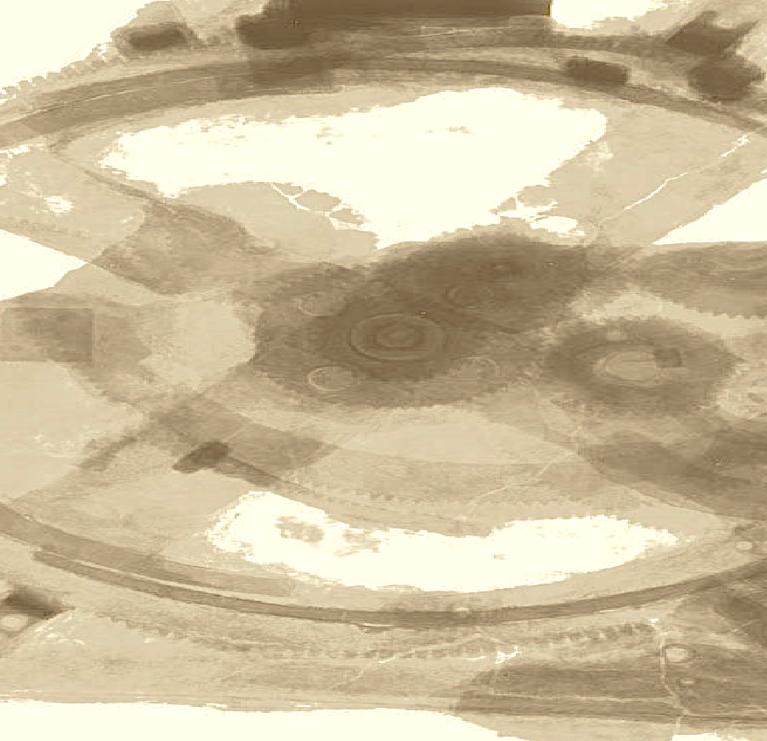

Drops of LTSpice
Working with WAV files

Slide 2
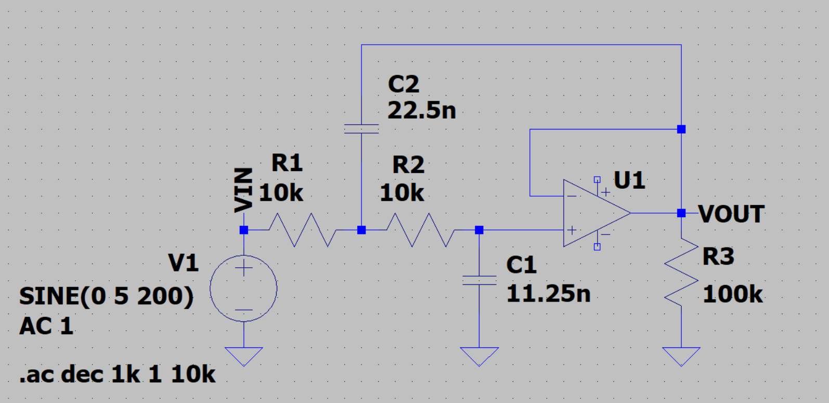
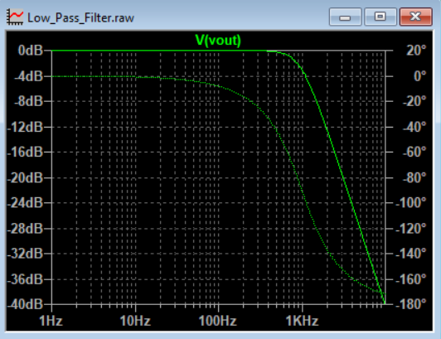
So, you are working with audio and created a filter.
It seems to be working well.

Slide 3
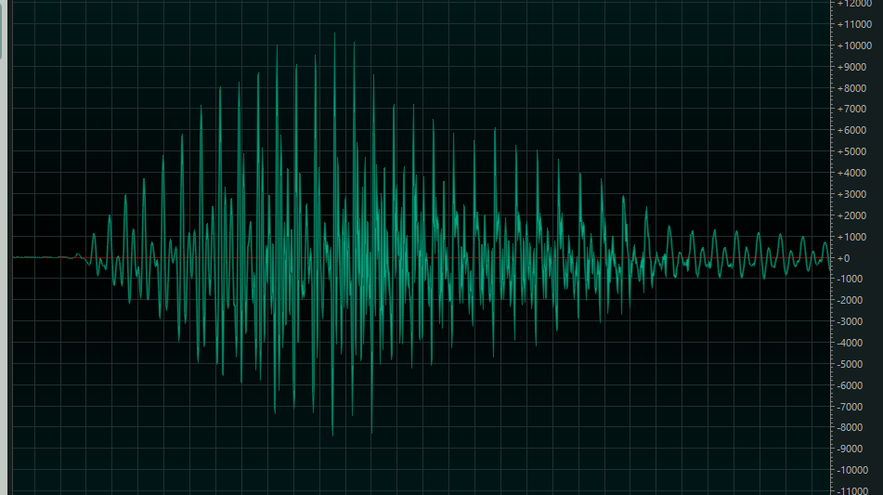
But it would be so cool if you could put on a real song and see the results of your filter, right?
Yes, LTSpice can do this!

Slide 4
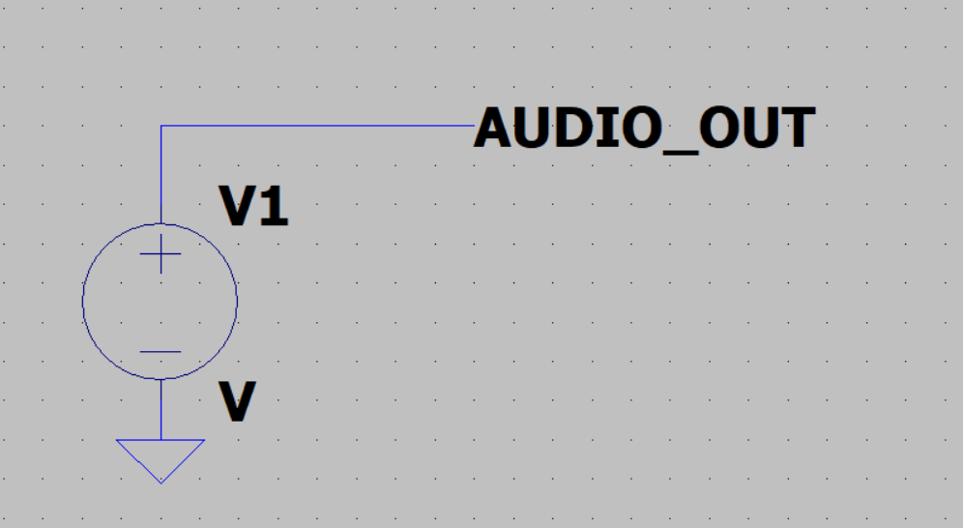
First, let's understand how to open an audio file.
This is a Voltage Source feature.
First, hold CTRL and right-click on Voltage Source.

Slide 5
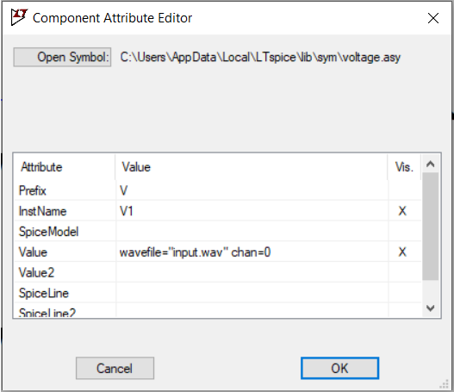
In Value, add the line:
wavefile="input.wav" chan=0
The chan parameter is not mandatory. It’s to select the channel if it is stereo.

Slide 6
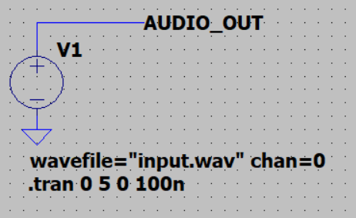
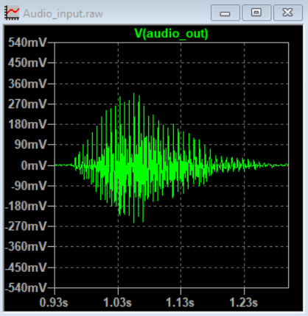
And done!
Your audio is already inside the LTSpice.

Slide 7
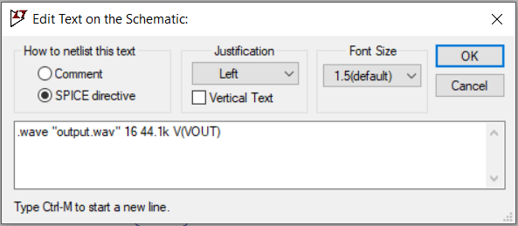
Recording output WAV files is also very easy. First, add a directive.
File
Name
Sample
Rate
Channel
Number
of bits

Slide 8
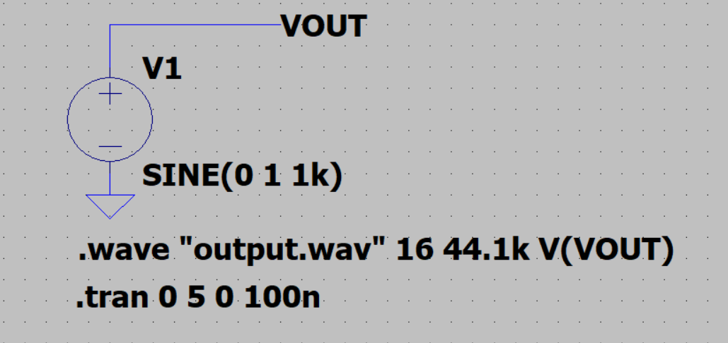
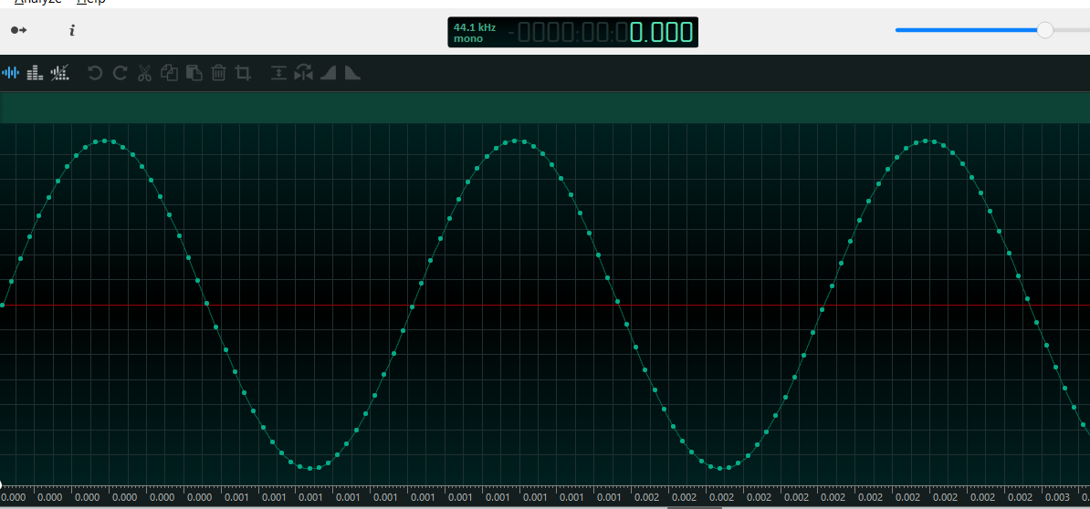
And done!
Your simulation already creates the WAV file.

Slide 9
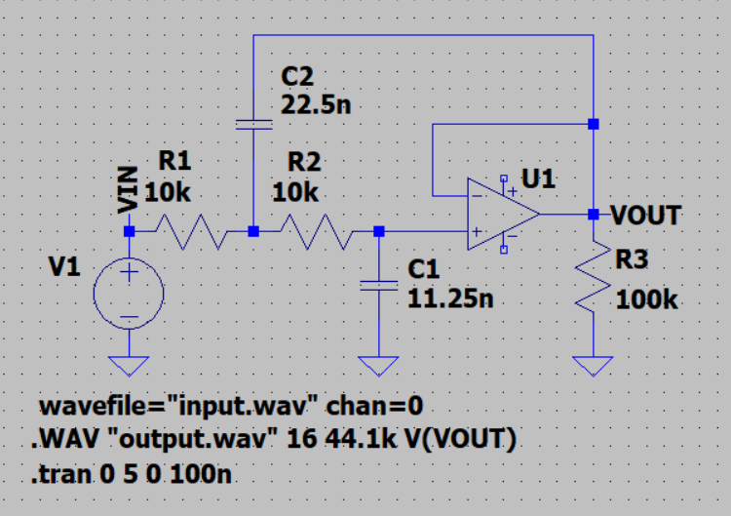
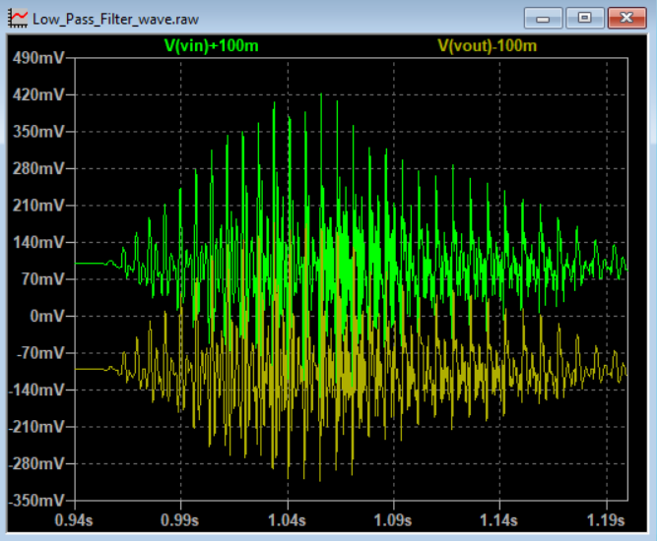
Now, you can really test your filter.
Francesco Sacco
linkedin.com/in/saccofrancesco

